Slide 1

Emission Representation in Energy System Models
Emissions can be fuel-dependent: CO₂ emissions can be estimated fairly accurately based on the total amount of fuels combusted and the averaged carbon content of the fuels
1 tonne of bituminous coal
2,563 kg of CO₂
Since 1 tonne of coal gives 28.5 GJ
1 PJ of bituminous coal
88 kt of CO₂
Notes:
https://www.epa.gov/sites/production/files/2015-07/documents/emission-factors_2014.pdf

Slide 2
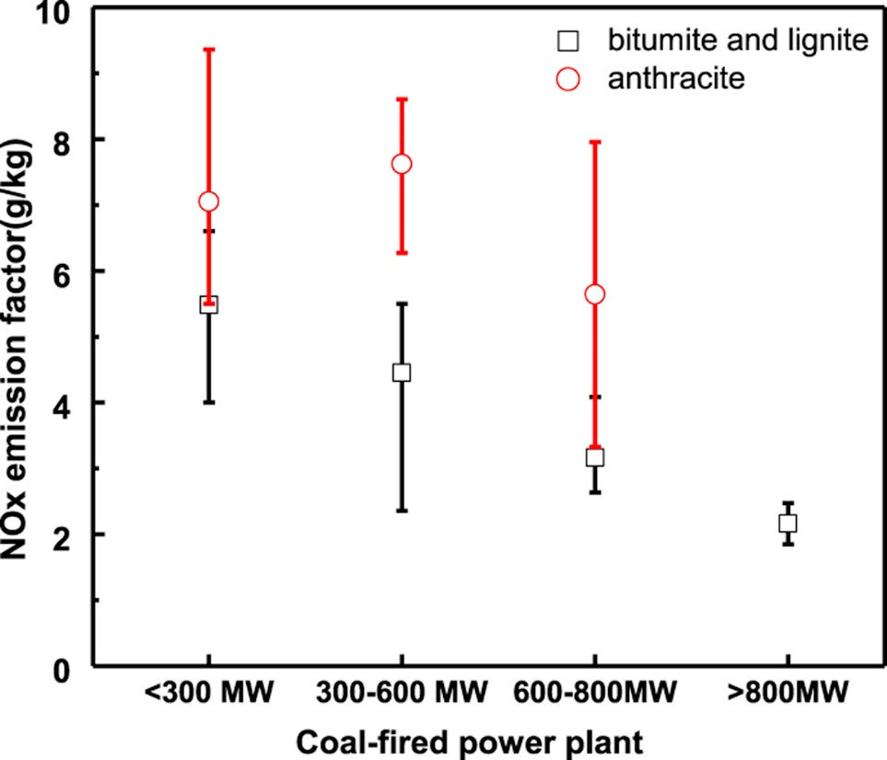
Emission Representation in Energy System Models
Emissions can be technology-dependent: Emission factors for NO_{x} depend on the combustion technology and operating conditions and vary significantly, both between individual installations and over time
Source: Ma et al., 2016. Characteristics of NOx emission from Chinese coal-fired power plants equipped with new technologies

Slide 3

Emission Representation in Energy System Models
Emissions can be technology-dependent: Emission factors for NO_{x} depend on the combustion technology and operating conditions and vary significantly, both between individual installations and over time
Depending on the technology and existence of potential pollution abatement technologies
1 kWh of electricity
X g of NO_{x}

